Slide 1

Mentor Liaison Training
(K-8)
Notes:
2021-2022

Slide 2
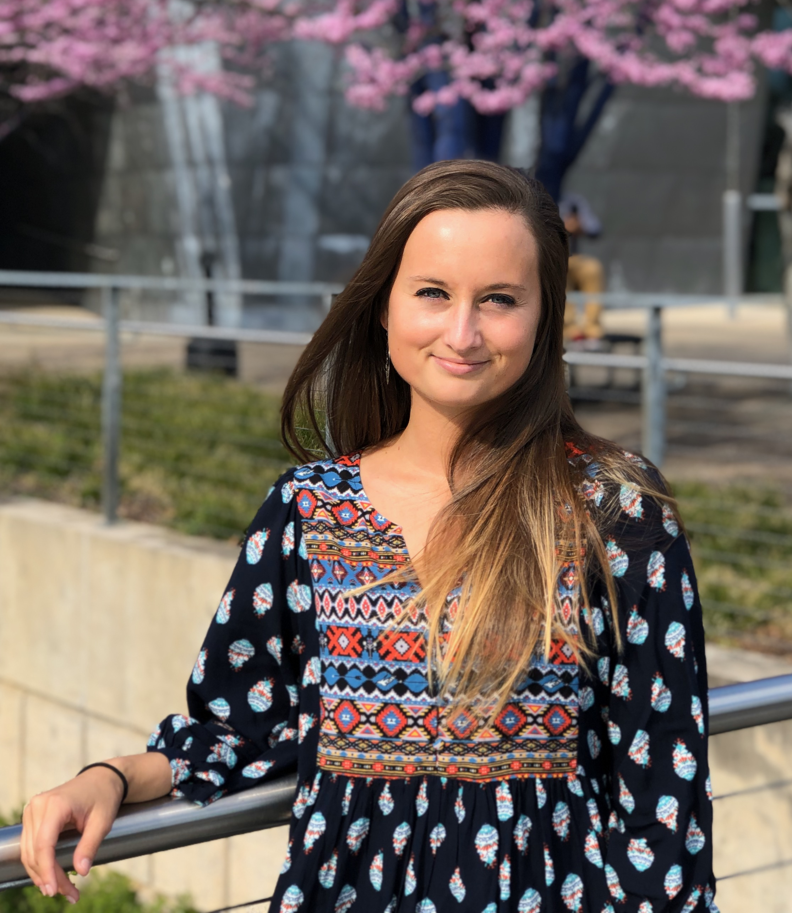
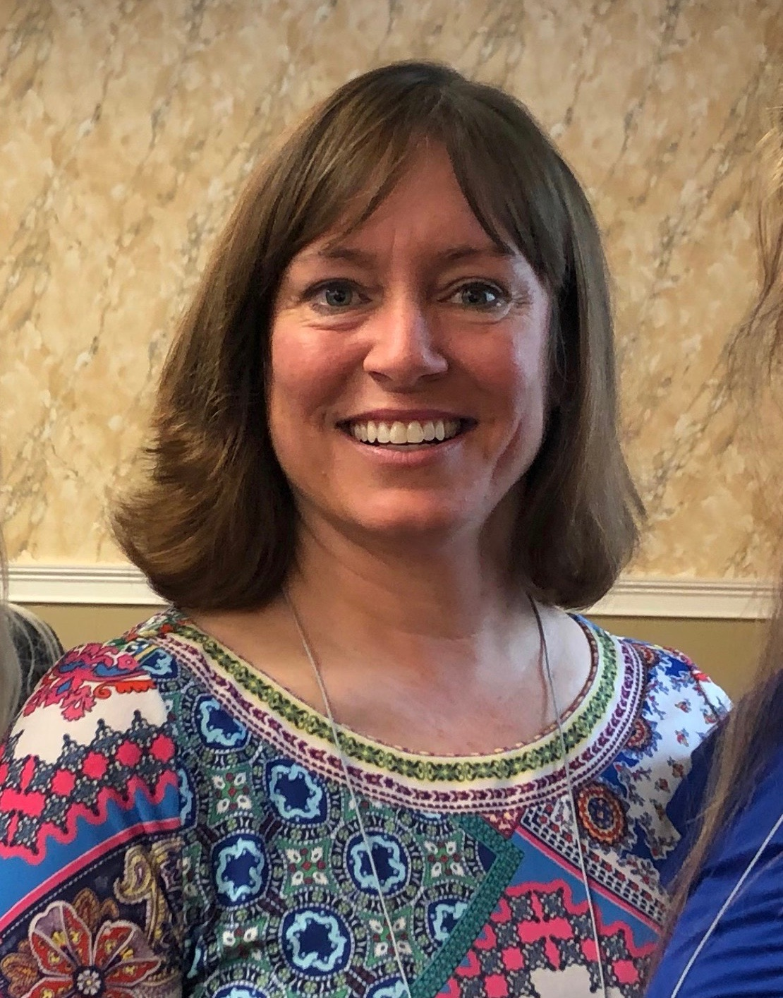
SFFC Foundation
The SFFC Foundation is a nonprofit organization based in Nashville, TN. Our current initiatives include the PFE Scholarship and Nourish Grants for individuals/families.
Administration Team
Ashley Beisiegel Jackie Downs
K-8 Program Officer 9-12 Program Officer
Office Number: (615) 675-0450

Slide 3
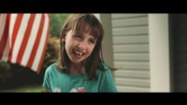
Origin Video

Slide 4

Your Commitments
Meet with each mentor and provide an introduction/orientation to PFE before visits start for the year, making sure the mentor understands the goals and expectations.
Ensure that each mentor’s needs are being met and that the match is effective by checking in with each mentor once per month.
Partner with Coordinator to assure that students are matched with mentors to ensure compatibility and a nurturing environment, as well as compliance with policies and guidelines.
Communicate with Coordinator if any match concerns arise from monthly check-ins.
Write a personal note of thanks from the Mentor Liaison to the mentors at the end of the school year.

Slide 5
Student/Mentor Matches
PFE was designed to ease senior isolation.
An ideal mentor is a cognitively healthy, older adult or someone with a disability who could use company and/or light assistance around the home.
Mentor Selection
Families can choose their own mentors (1 for each child) or your team may provide a list of suggested mentors from your community.
Non-negotiable criteria:
No nursing home residents.
Cognitive health
Commitment: A mentor must be able to commit to consistent, weekly visits.
Students may not be matched with a relative by any degree.
Reflect on past mentors in your life as you help your students choose theirs.

Slide 6

Match Checklist
No two student/mentor matches are alike. Keep this guide in mind to achieve successful matches. Look for a majority of below characteristics to be met as the intergenerational relationship grows through weekly PFE visits.
Senior loneliness is eased
Student is learning something
Mentor is learning something
Service is occurring
An intergenerational relationship is growing
Consistent visits occur
Students demonstrate accountability
Also look for:
Committed parents
Passionate local donors
Involved churches

Slide 7

Mentor Orientation
You or your Mentor Liaison are required to communicate with each mentor at the beginning of the year before students start visiting.
Each conversation should be comprised of the following elements:
Program goals
Program expectations (consistency of visits, appropriate activities, the mentor’s role, etc.)
What the visits should/might look like
Providing the mentor packet
Contact information for the Mentor Liaison

Slide 8

Mentor Check-ins
Partner with the Coordinator to check in with your mentors each month.
You should address the following items:
How does the mentor feel the visits are going? Why does the mentor feel this way?
Are the mentor’s needs being met? (Is the student attentive, helping with needed chores, etc.)?
Is a relationship forming between the mentor and student?
Does the mentor feel as if he/she is able to positively influence the student?

Slide 9

Safety
In order to keep each student/mentor safe while visiting:
A parent or legal guardian (K-8 students) is required to accompany each visit. They are responsible for their child’s safety.
Visits that occur without parental supervision will be declined.
Make sure you are complying with any of your conference’s policies for student safety, including background checks, if applicable.

Slide 10

Impact Video

